Slide 1

BLACK FRIDAY SALES
BY: Soumit Kar

Slide 2
About
Black Friday sales dataset
By Retail Stores
550,068 observations
Contains:
Numerical Variables
Categorical Variables
Some missing values

Slide 3
Process
Downloaded data
Data Gathering
Exploring Data
Cleaning Data
Final Formatting of Data

Slide 4
R Packages Used
UsingR : for Introductory Statistics
Sampling : Functions for drawing and calibrating samples
Stringr:
There are four main families of functions in stringr:
o Character manipulation: these functions allow you to manipulate individual characters within the strings in character vectors.
o Whitespace tools to add, remove, and manipulate whitespace.
o Locale sensitive operations whose operations will vary from locale to locale.
o Pattern matching functions. These recognise four engines of pattern description. The most common is regular expressions, but there are three other tools.

Slide 5
Tidyverse :
The 'tidyverse' is a set of packages that work in harmony because they share common data representations and 'API' design.
Using it for TIBBLE in project
stats
For R statistical functions
prob
A framework for performing elementary probability calculations on finite sample spaces, which may be represented by data frames or lists.
dbplyr
This implements the data table back-end for 'dplyr' so that you can seamlessly use data table and 'dplyr' together.
dtplyr
This implements the data table back-end for 'dplyr' so that you can seamlessly use data table and 'dplyr' together.

Slide 6
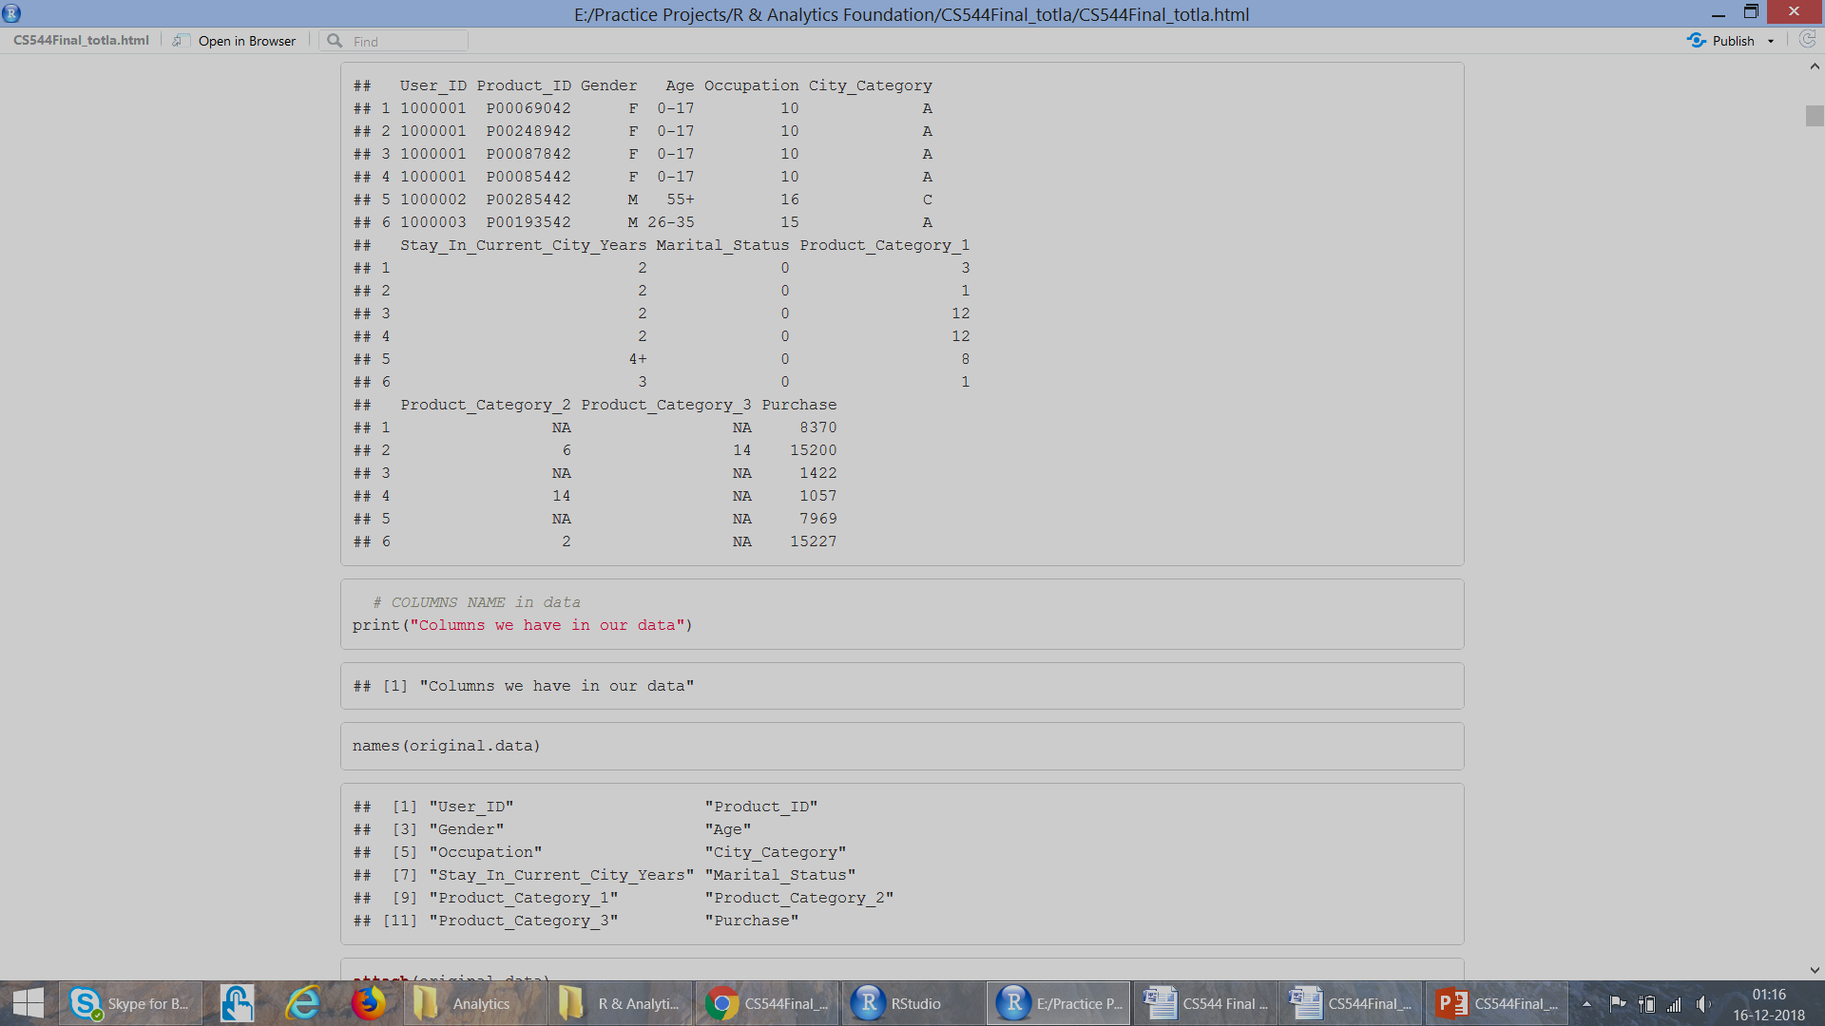
Attributes in Data
User_ID (Numerical Variable)
Product_ID (Categorical Variable)
Gender (Categorical Variable)
Age (Categorical Variable, because it is in ranges)
Occupation (Numerical Variable)
City_Category (Categorical Variable)
Stay_In_Current_City_Years (Numerical Variable)
Marital_Status (Numerical Variable)
Product_Category_1 (Numerical Variable)
Product_Category_2 (Numerical Variable)
Product_Category_3 (Numerical Variable)
Purchase amount in dollars (Numerical Variable)

Slide 7
Exploring Attributes
User Id: Not Unique, maps person to the particular purchase
Product Id: Not Unique, tells how many purchases are made for a product
Gender: Have only two variables: F M
Age: It is divided into 7 ranges, Here Age is Categorical Variable
Occupation: There are 21 different occupation ranging from 0-21
City Category: Cities in which customers have lived is categorized into three categories: A, B, C
Year.. : People have lived in the current city for 0-5 years. Here 5 could mean atleast 5 years
Marital Status: People have their marriage status marked as either 0 or 1
Product Category 1: Ranges form 1-18
Product Category 2: Ranges form 2-18
Product Category 3: Ranges form 3-18
Purchase: It is the amount people spent in $ for purchases. Not unique.

Slide 8
Analysis..

Slide 9
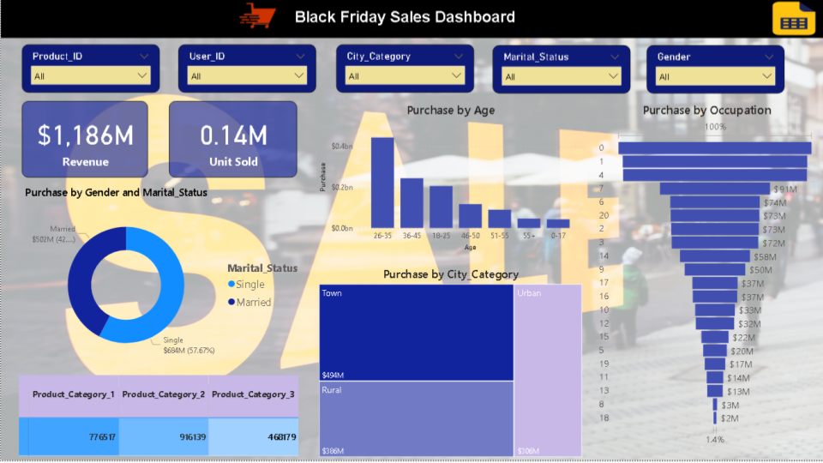
Power BI Dashboard

Slide 10
Power bi chart
Slicer : Product id, user id, gender, marital status
Score Card : Total revenue, unit sold, city
Chart:
Purchase by gender and marital status (donut chart)
Product category wise purchase (matrix table)
Purchase by city category (tree map)
Purchase by age distribution (barplot)
Purchase by occupation (funnel chart)

Slide 11
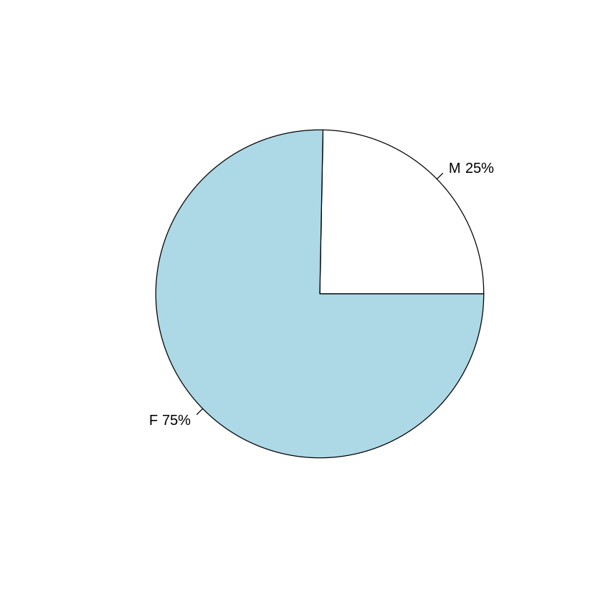
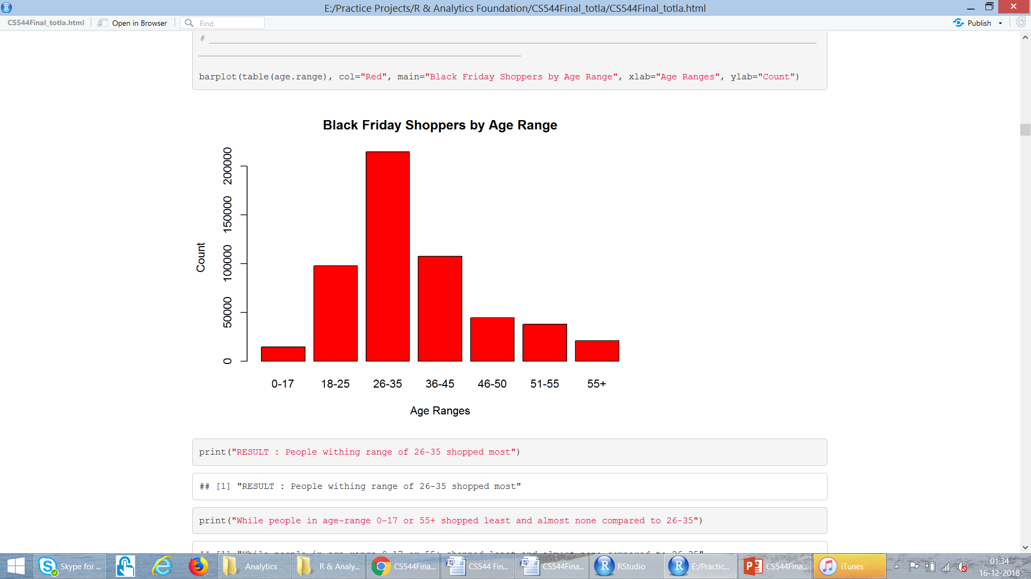
Gender
We can conclude that Male(75%) shop more than Female(25%) by the pie chart.
People within range of 26-35 shopped most.
While people in age-range 0-17 or 55+ shopped least and almost none compared to 26-35.
Also, overall people within age range 18-45 are the group which makes maximum population of shopping.

Slide 12
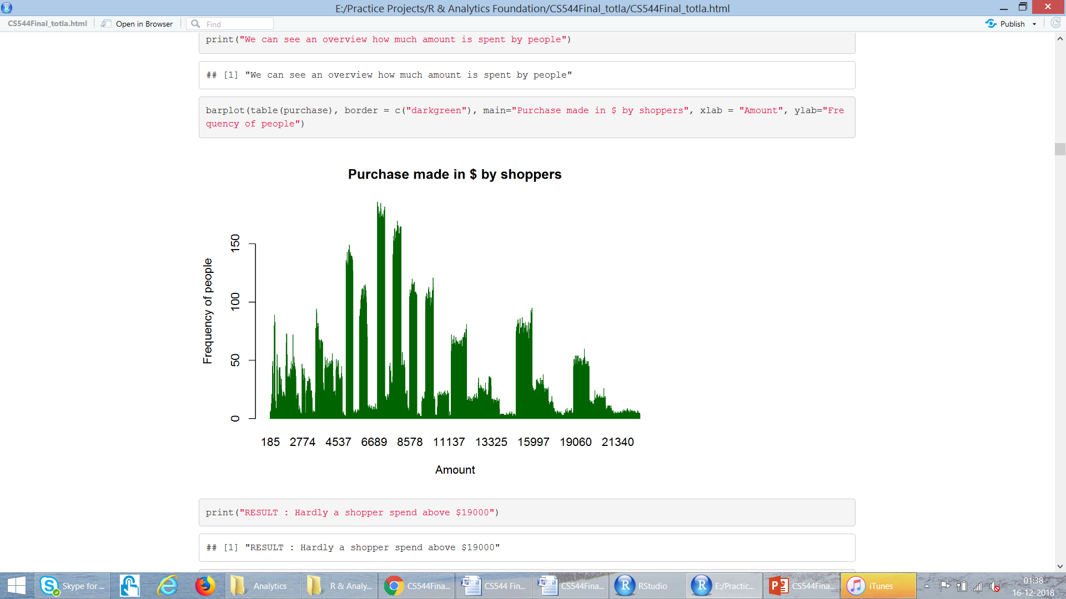
Analyse “Purchase” : Barplot
Average dollars shoppers spent = 9334
Hardly a shopper spend above $19000
Shoppers mostly spent an amount of approximately 6800 or 8700 as they got highest peak in barplot

Slide 13
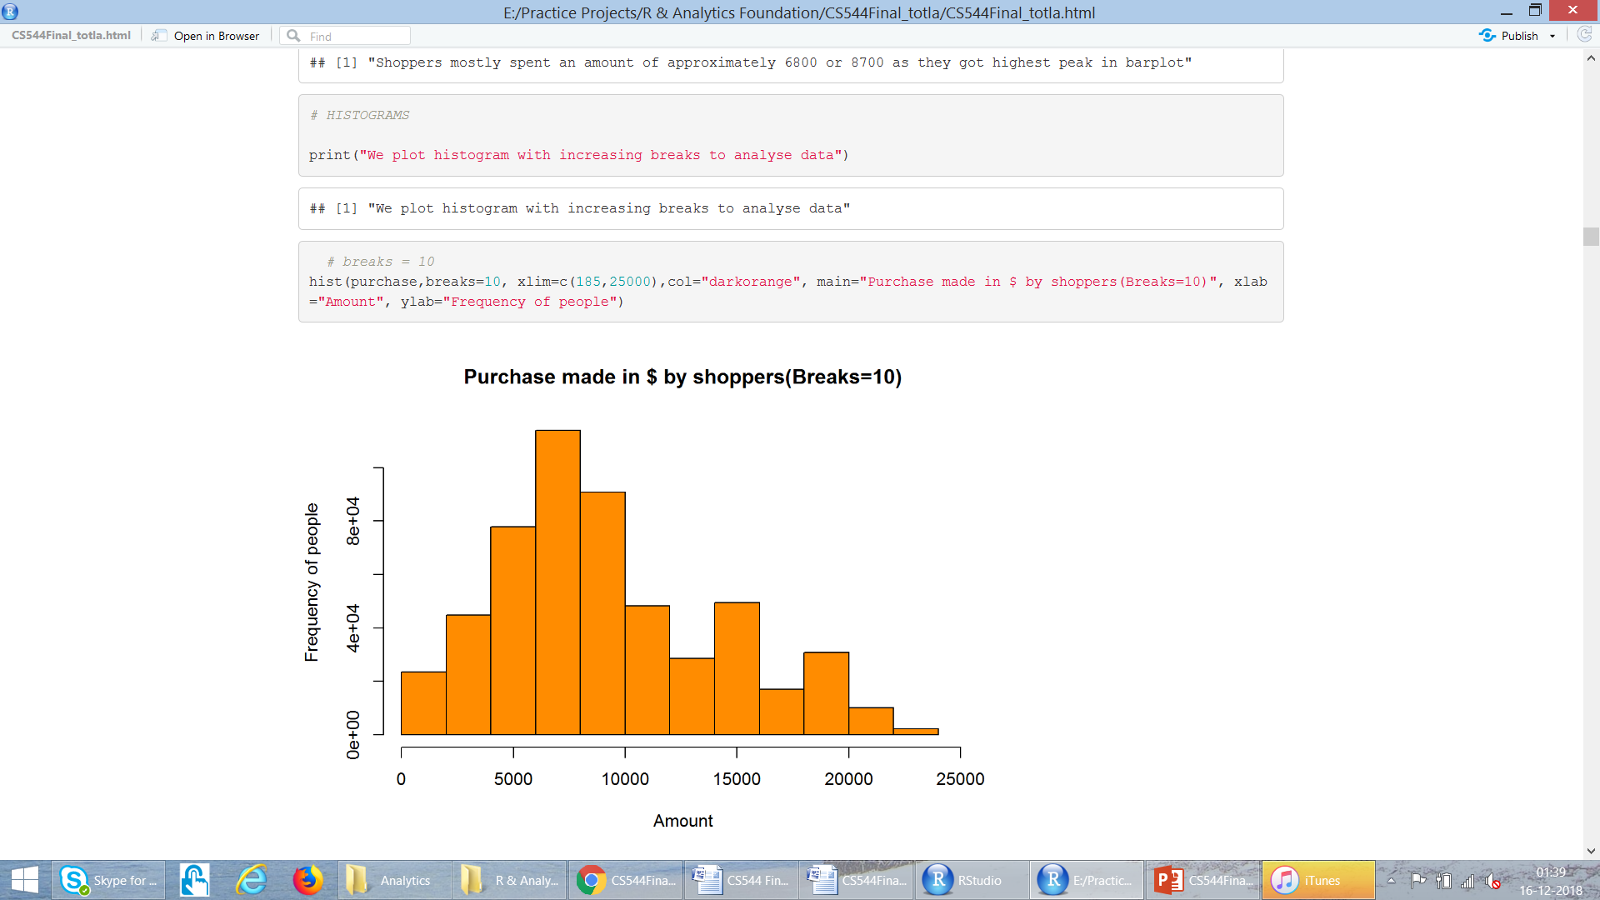
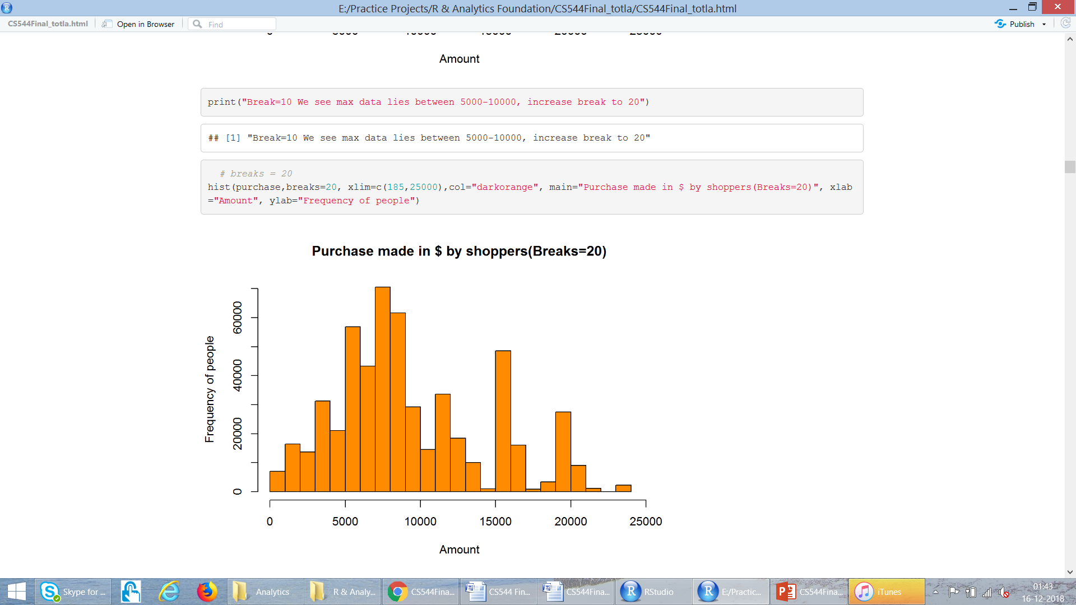
Analyse “Purchase” : Histograms
Break=10
We see max data lies between 5000-10000
Break = 20
We can see there are some figures which are not at all spent and good amount is spent near 15000 and b/w 5000-10000

Slide 14
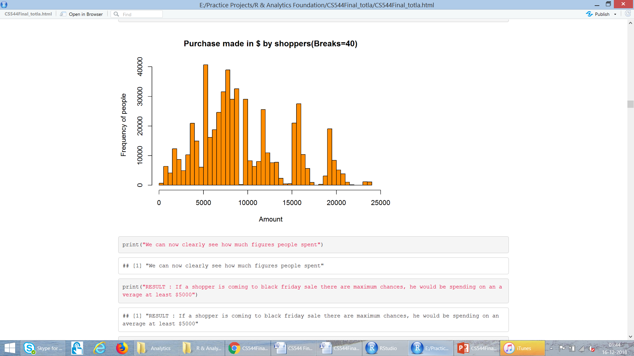
Analyse “Purchase” : Histograms
If a shopper is coming to black friday sale there are maximum chances, he would be spending on an average at least $5000.
Maximum shoppers population lie across $5000 mark.
Coincidence & Interesting to see a 0 frequency near 10,000, and mid of 15000-20000.
We may consider that people didn't spent in $9000 or $17000(avg of 15K & 20K) in sales.

Slide 15
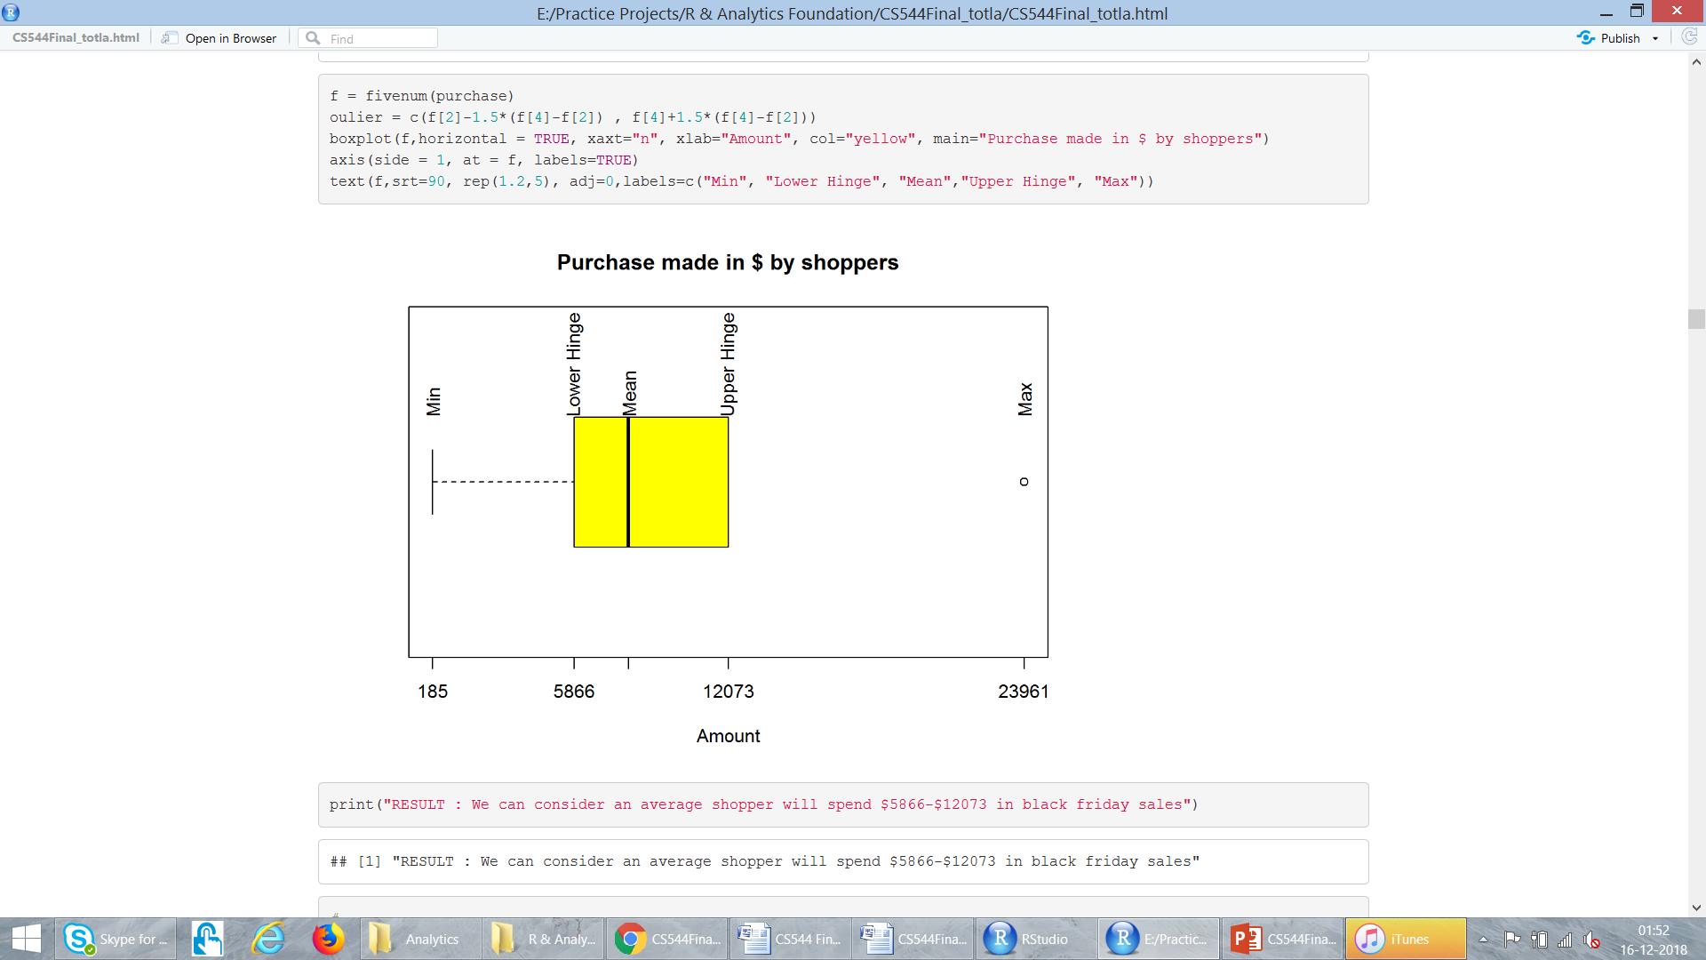
Analyse “Purchase” : Barplot
We can consider an average shopper will spend $5866-$12073 in black friday sales

Slide 16
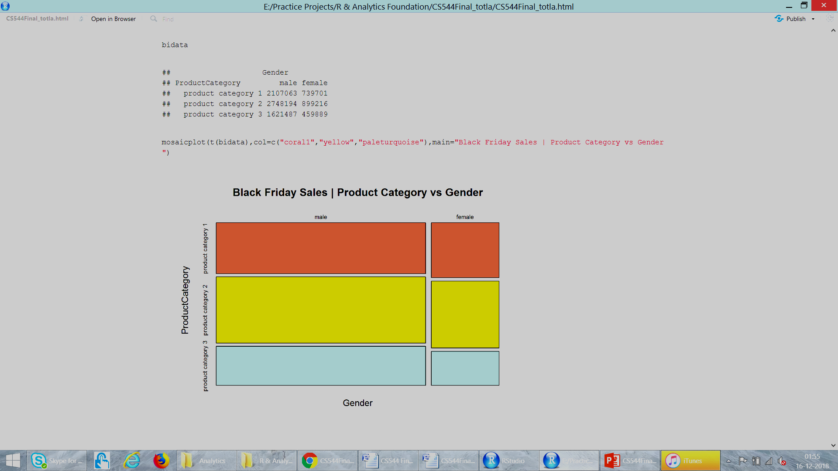
MULTIVARIATE DATA
Gender
Product Category 1
Product Category 2
Product Category 3

Slide 17
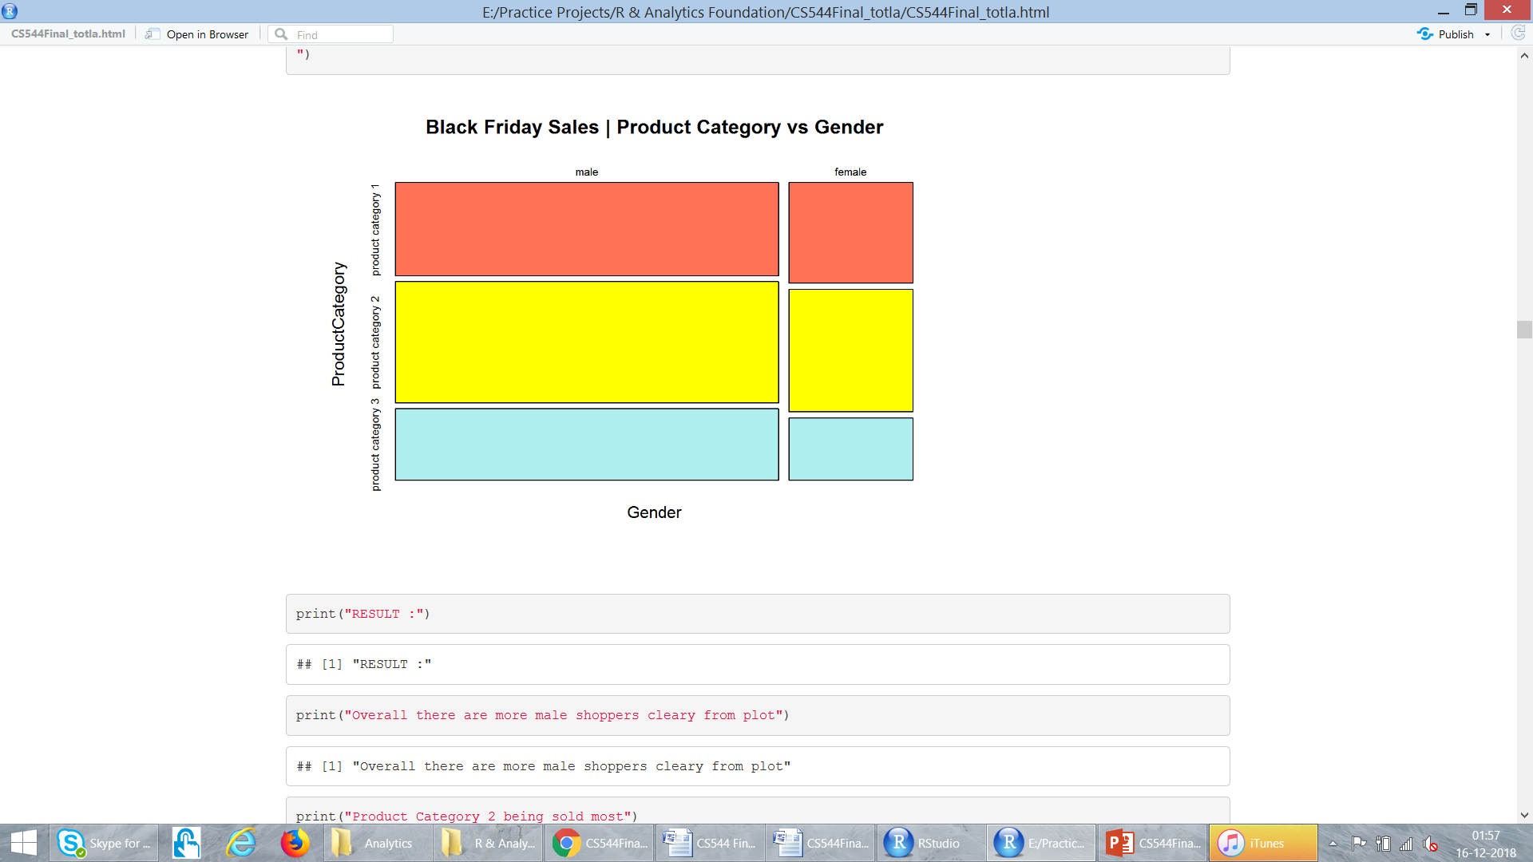
MULTIVARIATE DATA
Overall there are more male shoppers
Product Category 2 being sold most
Product category 3 sales are almost half of product category 2 in case of female shoppers

Slide 18
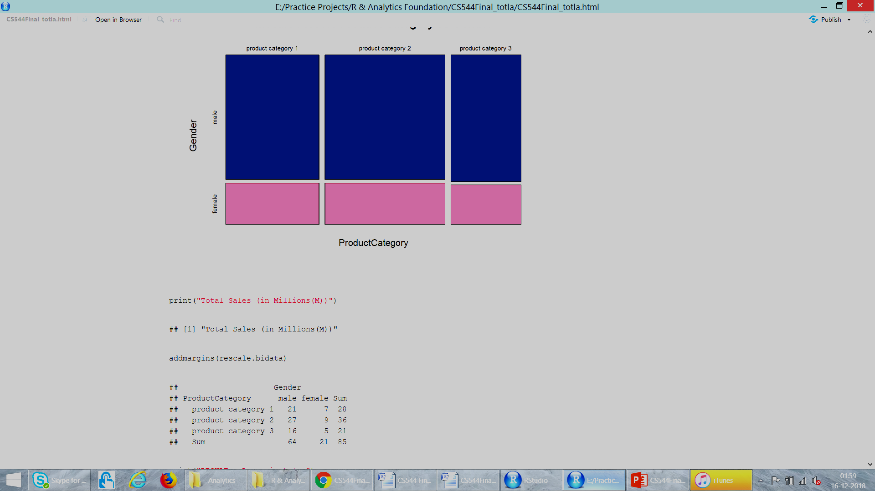
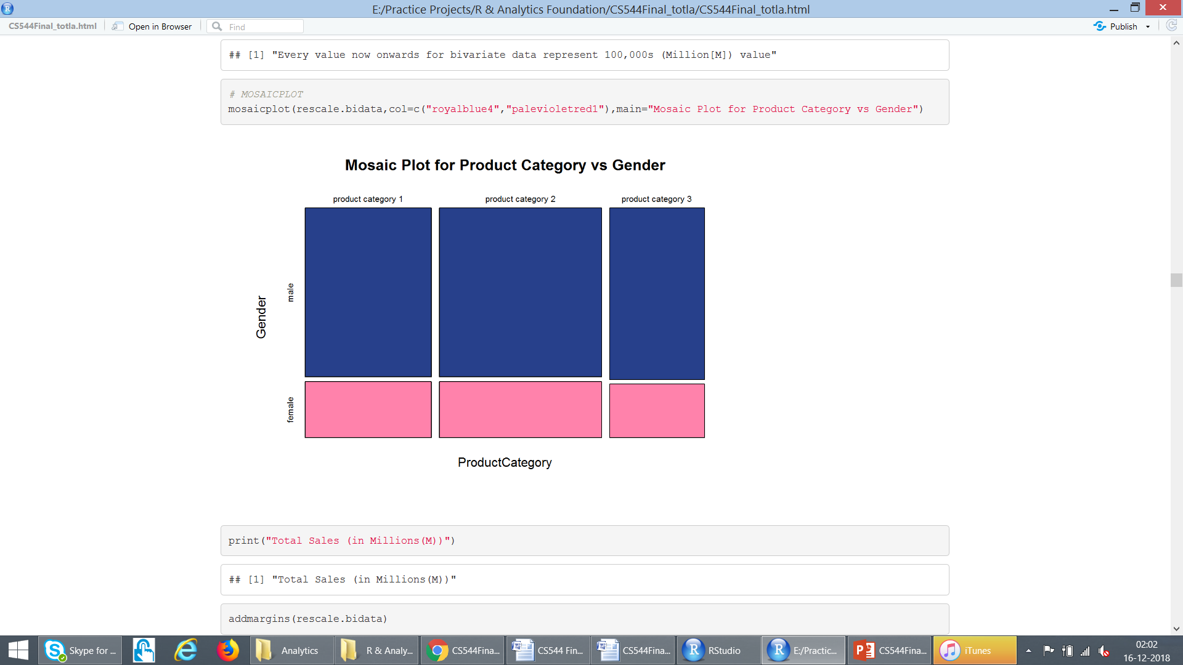
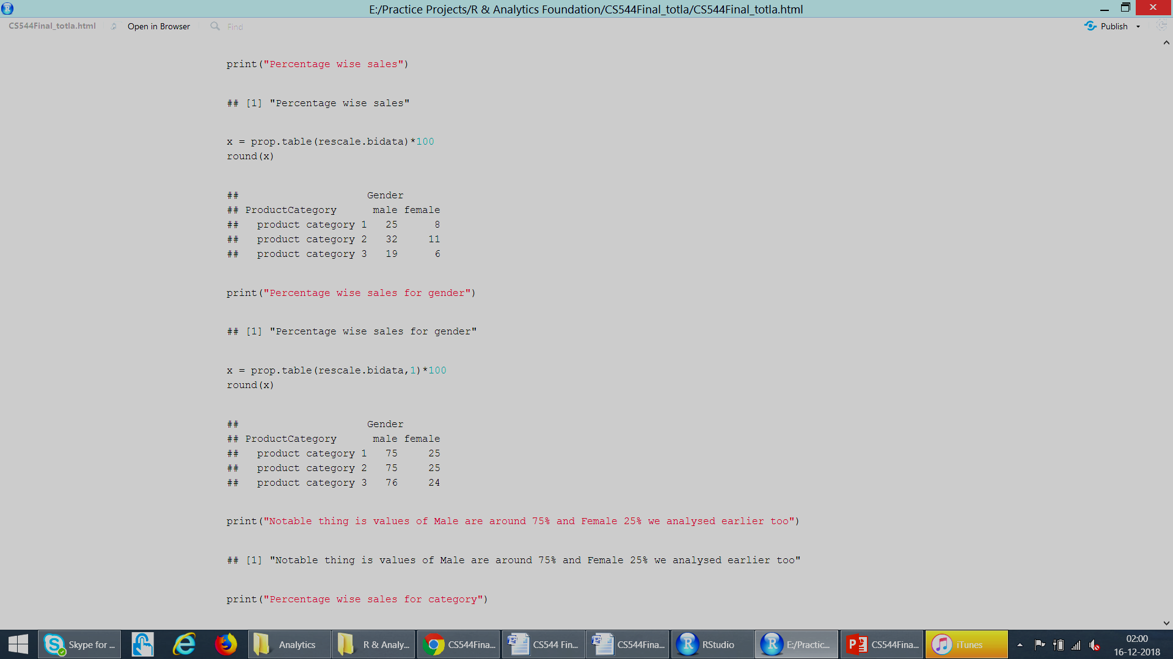
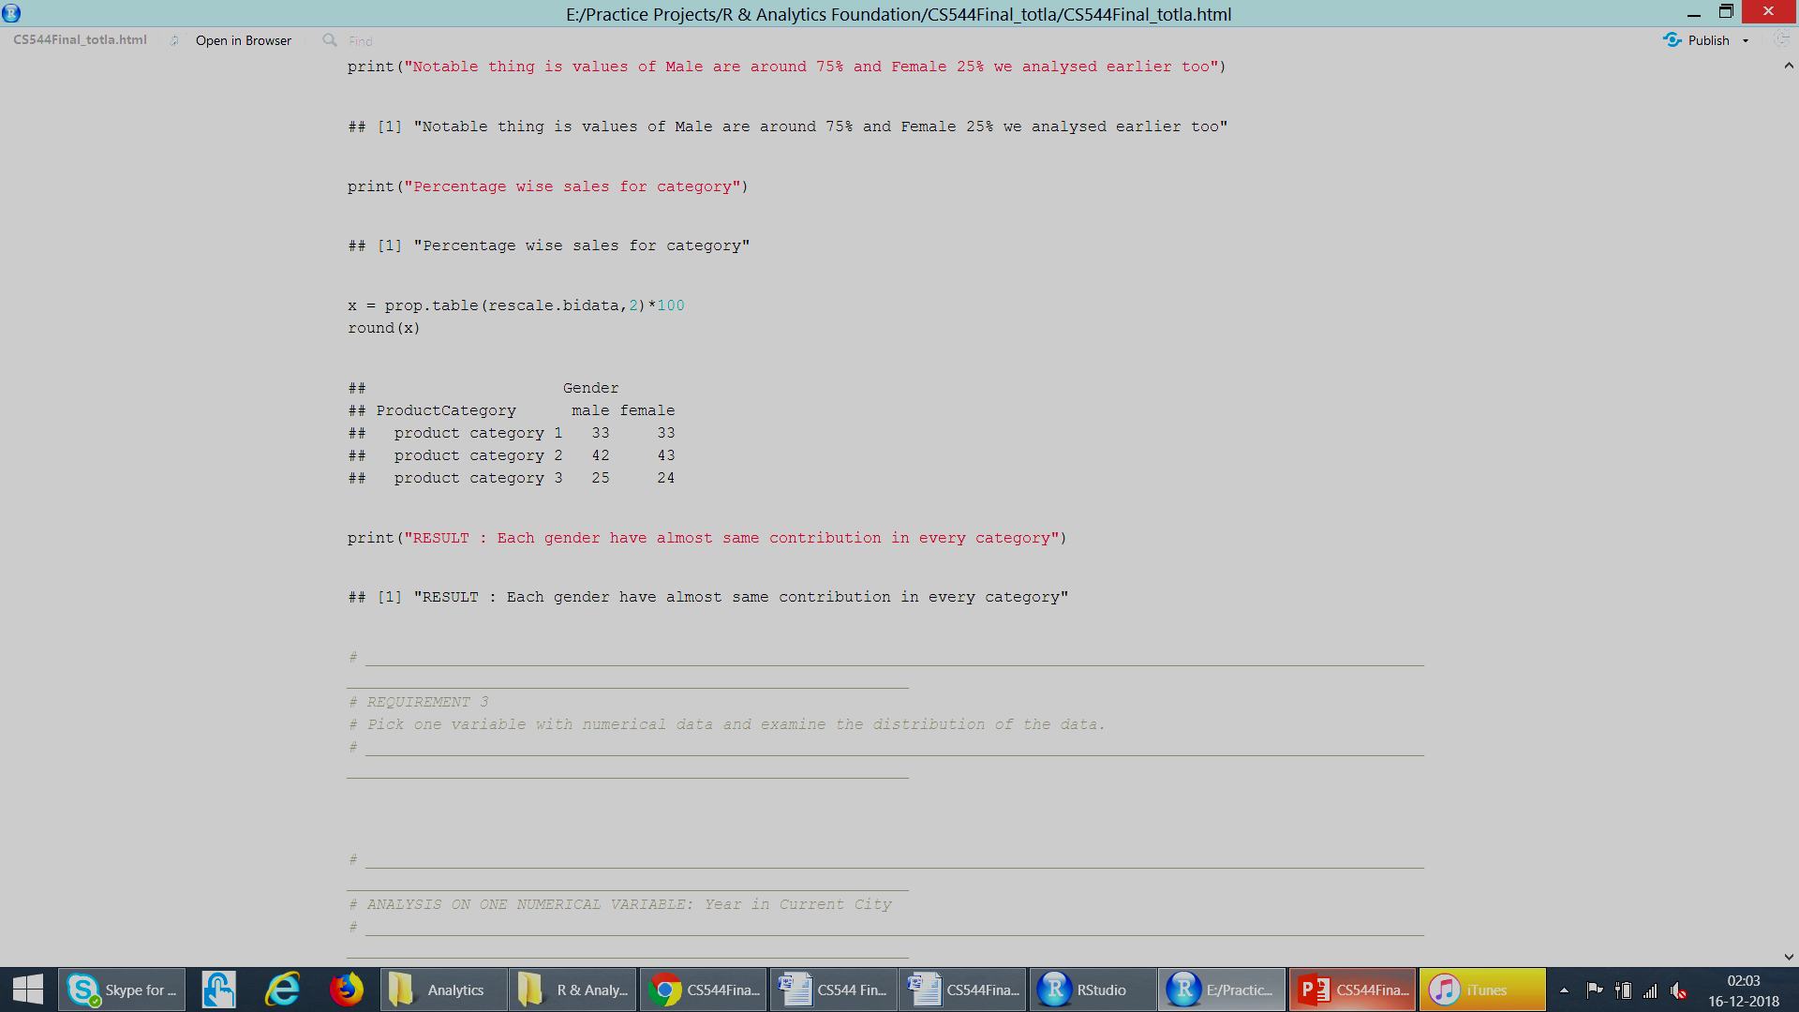
MULTIVARIATE DATA : Rescaled (values in Millions)
Overall
Gender
%tages
Product
Category
%tages
Each gender have almost same contribution in every category

Slide 19
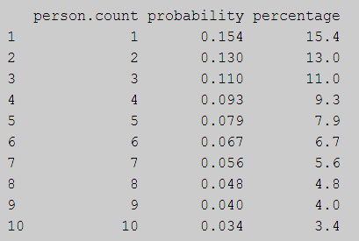
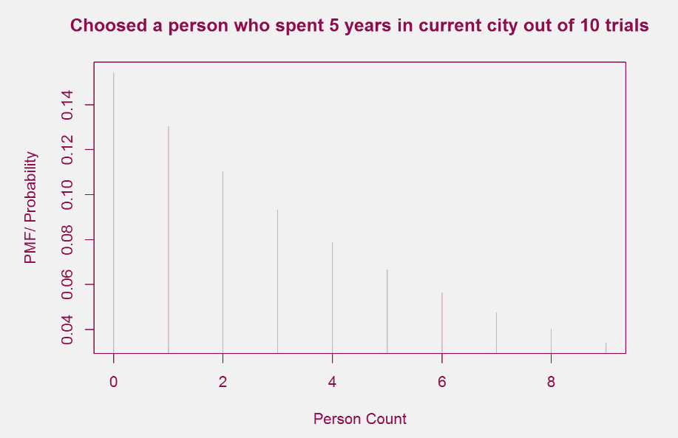
Analyse : “Years in Current City” Geometric Distribution
Probability that the person I picked have stayed 5 years in current city

Slide 20
Central Limit Theorem
The mean of the sample mean distribution is equal to the mean of the parent data.
The higher the sample size, the narrower the spread of the sample means.
Sample Sizes : 0.5% 1% 5% 30% 75% of total purchases set
 | Original = 18151 | 0.5% = 91 | 1% = 181 | 5% = 905 | 30% = 5432 | 75% = 13579 | Average of samples
Mean | 9.27 | 8.26 | 9.72 | 9.34 | 9.24 | 9.29 | 10.74
Std Dev. | 5.03 | 4.55 | 5.53 | 4.87 | 5.11 | 5.11

Slide 21
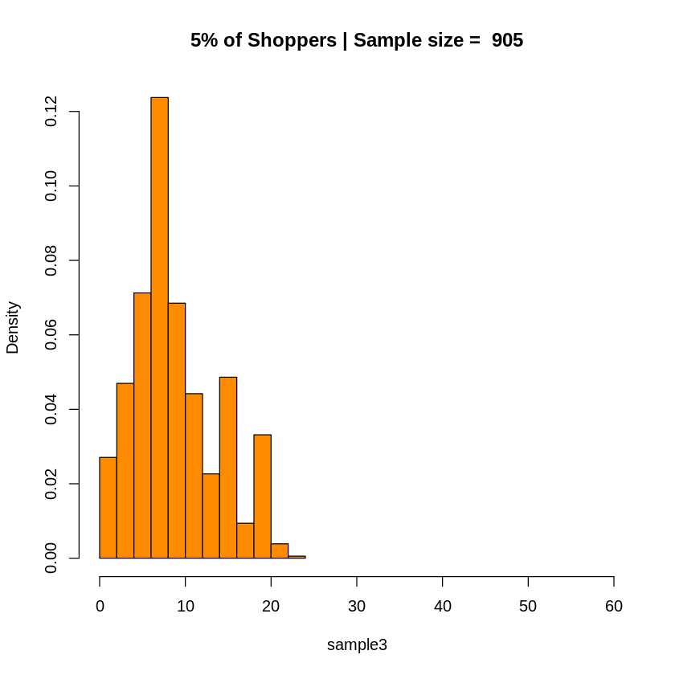
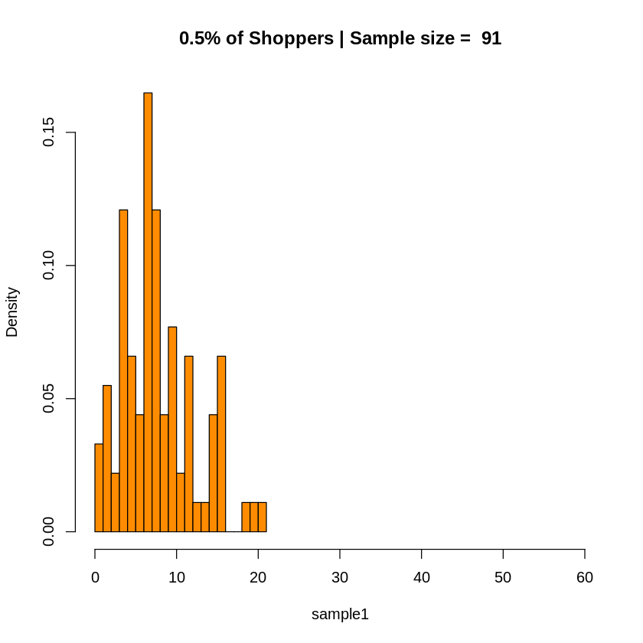
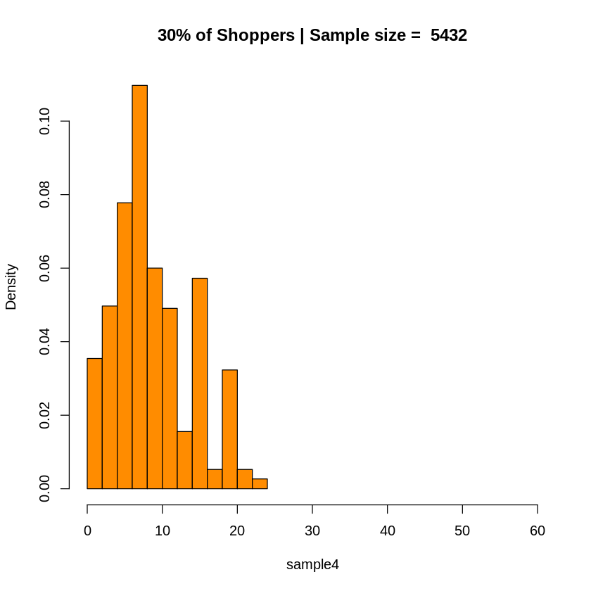

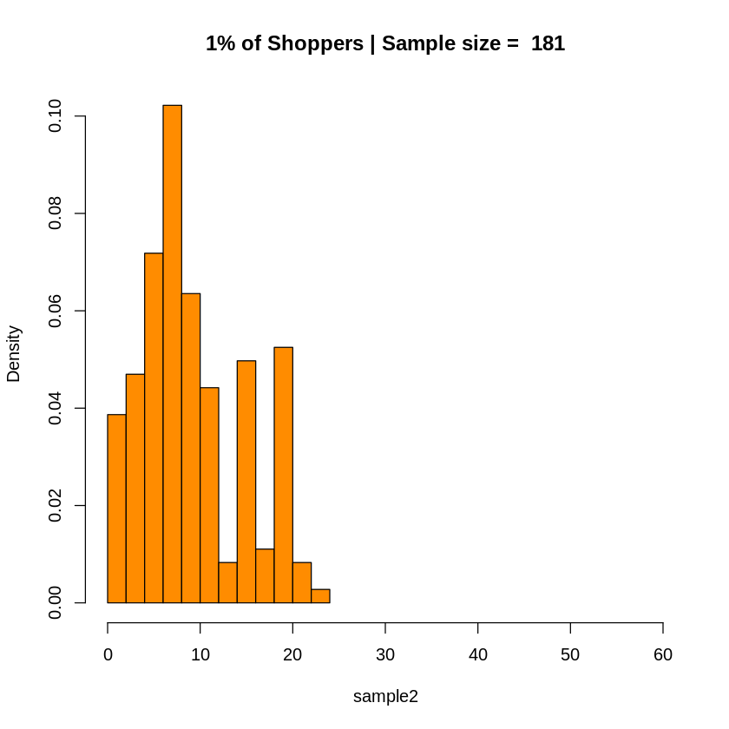
Central Limit Theorem

Slide 22
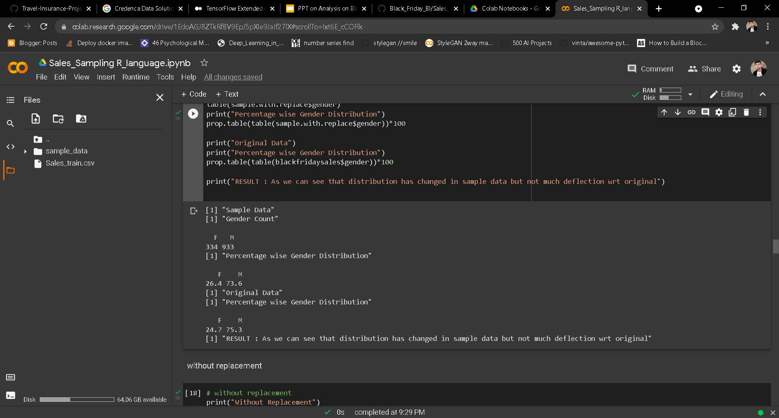
Simple Random Sampling : With Replacement
It is a method of selection of n units out of the N units one by one such that at each stage of selection, each unit has an equal chance of being selected, i.e., 1/ .

Slide 23
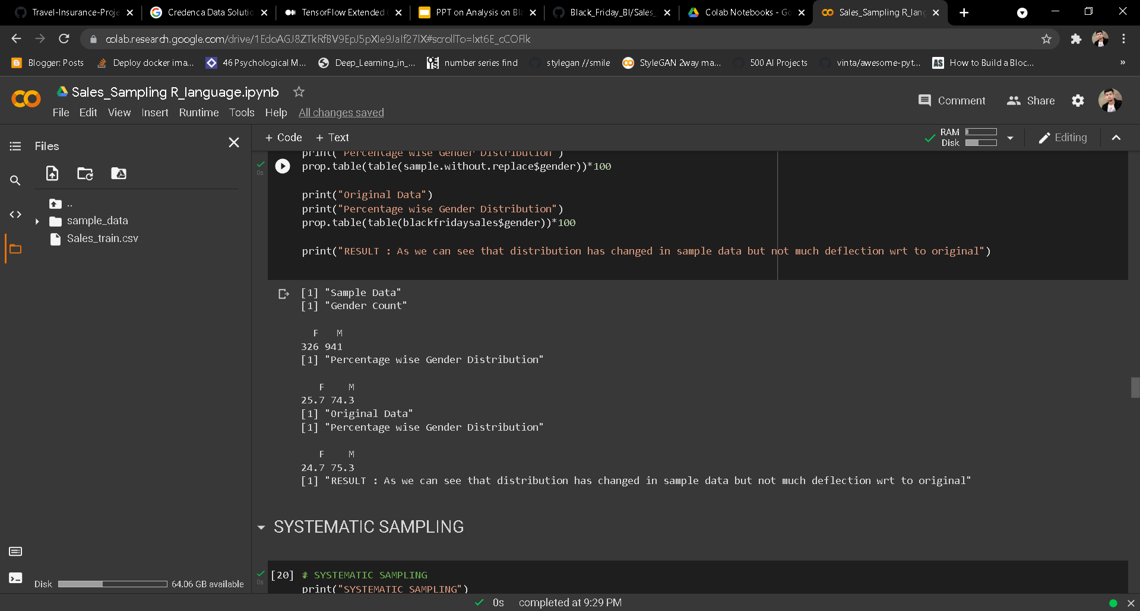
Simple Random Sampling : Without Replacement
It is a method of selection of n units out of the N units one by one such that at any stage of selection, any one of the remaining units have the same chance of being selected, i.e. 1/ . N

Slide 24
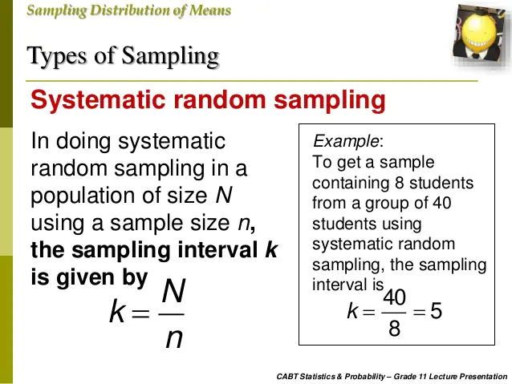
Systematic Sampling
Systematic sampling is a probability sampling method in which a random sample, with a fixed periodic interval, is selected from a larger population.

Slide 25
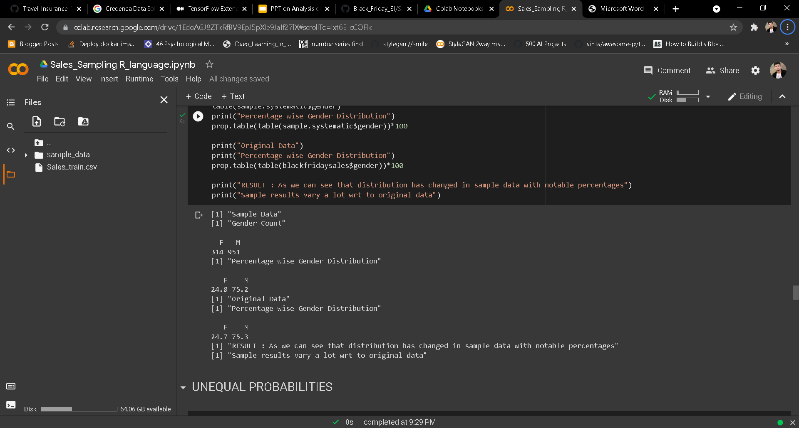
Systematic Sampling : Equal Probability

Slide 26
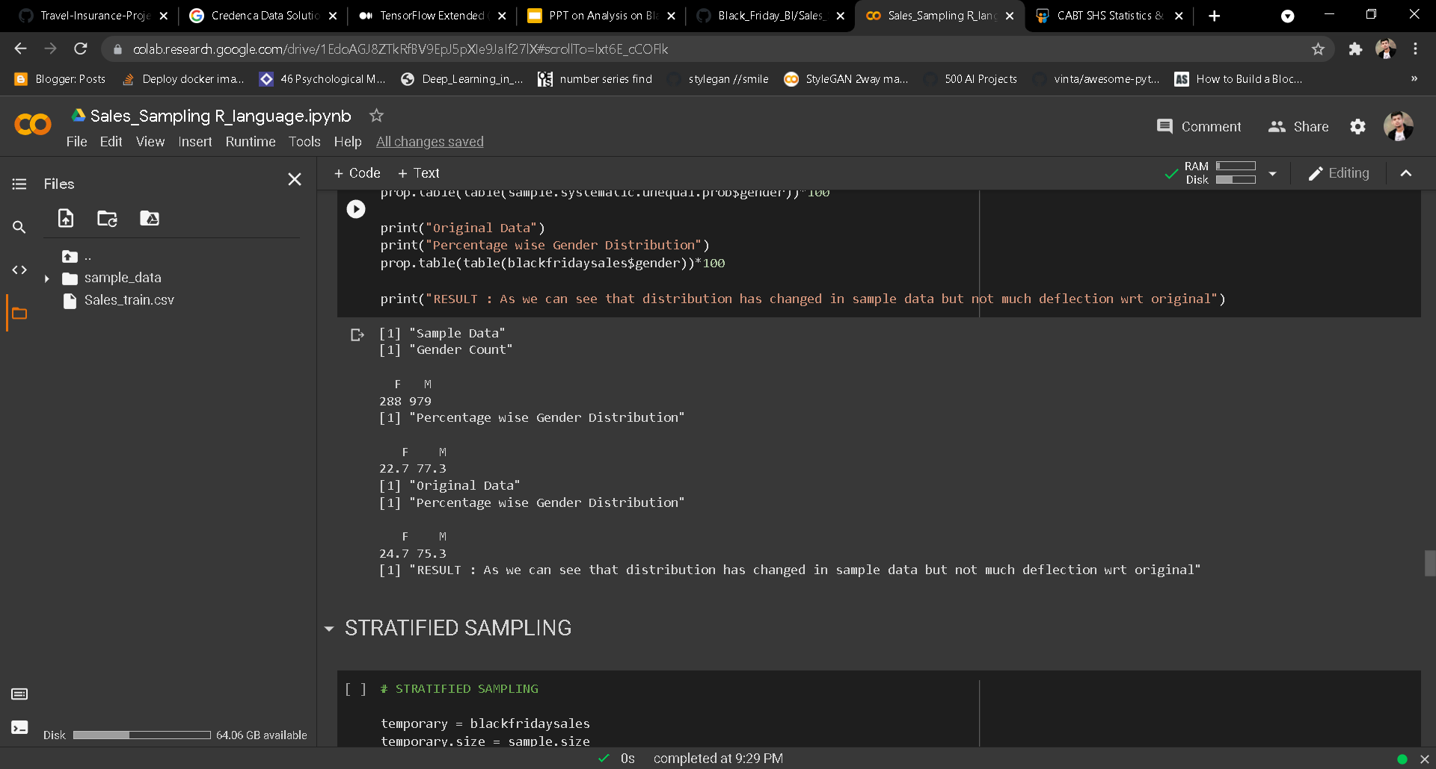
Systematic Sampling : Unequal Probability

Slide 27
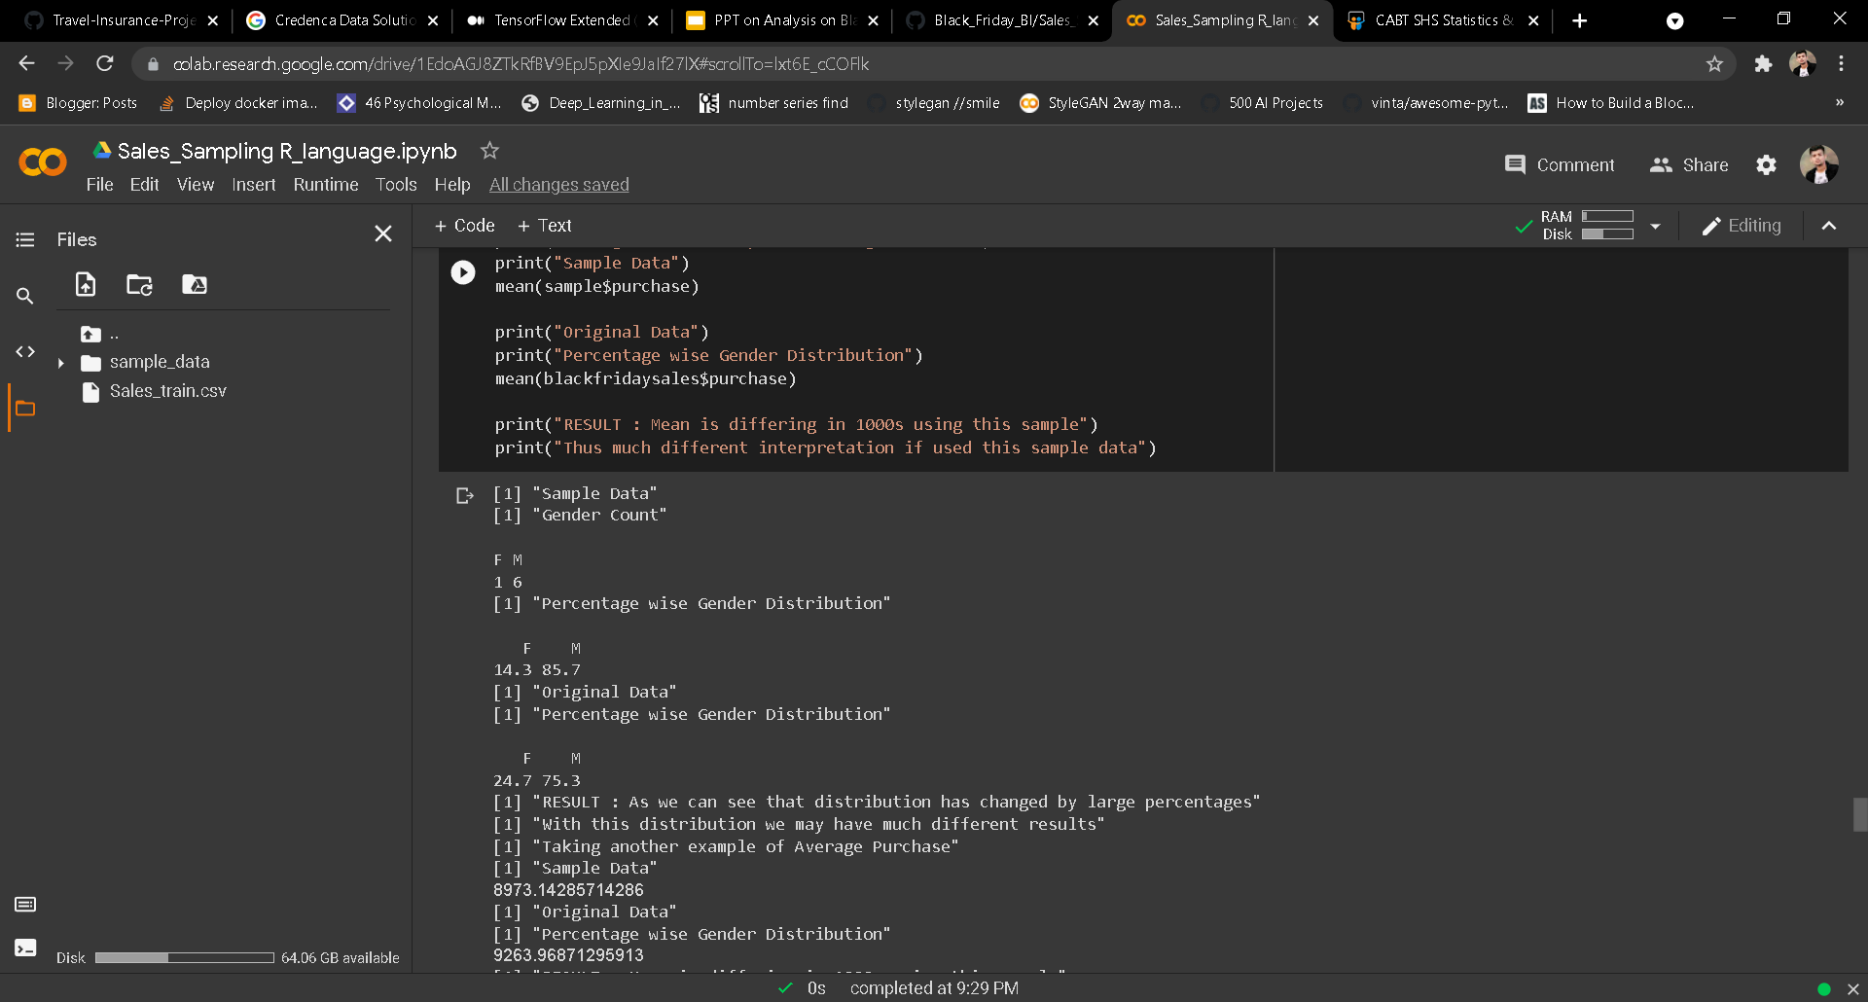
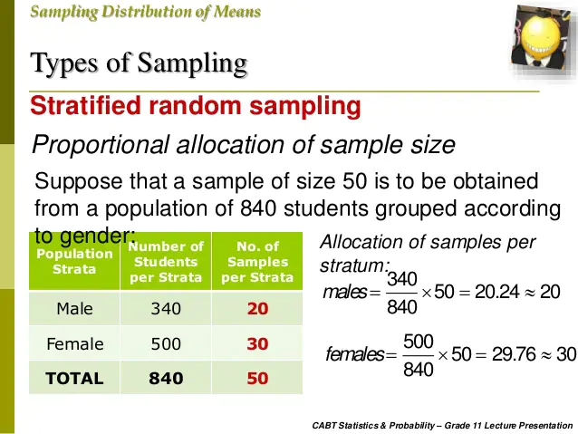
Stratified Sampling : Sample Size =10
E.g.
Suppose Sample size 50, population 840 and grouped according to gender
Population Strata | No of students | No of sample
Male | 340 | 20
Female | 500 | 30
Total | 840 | 50

Slide 28
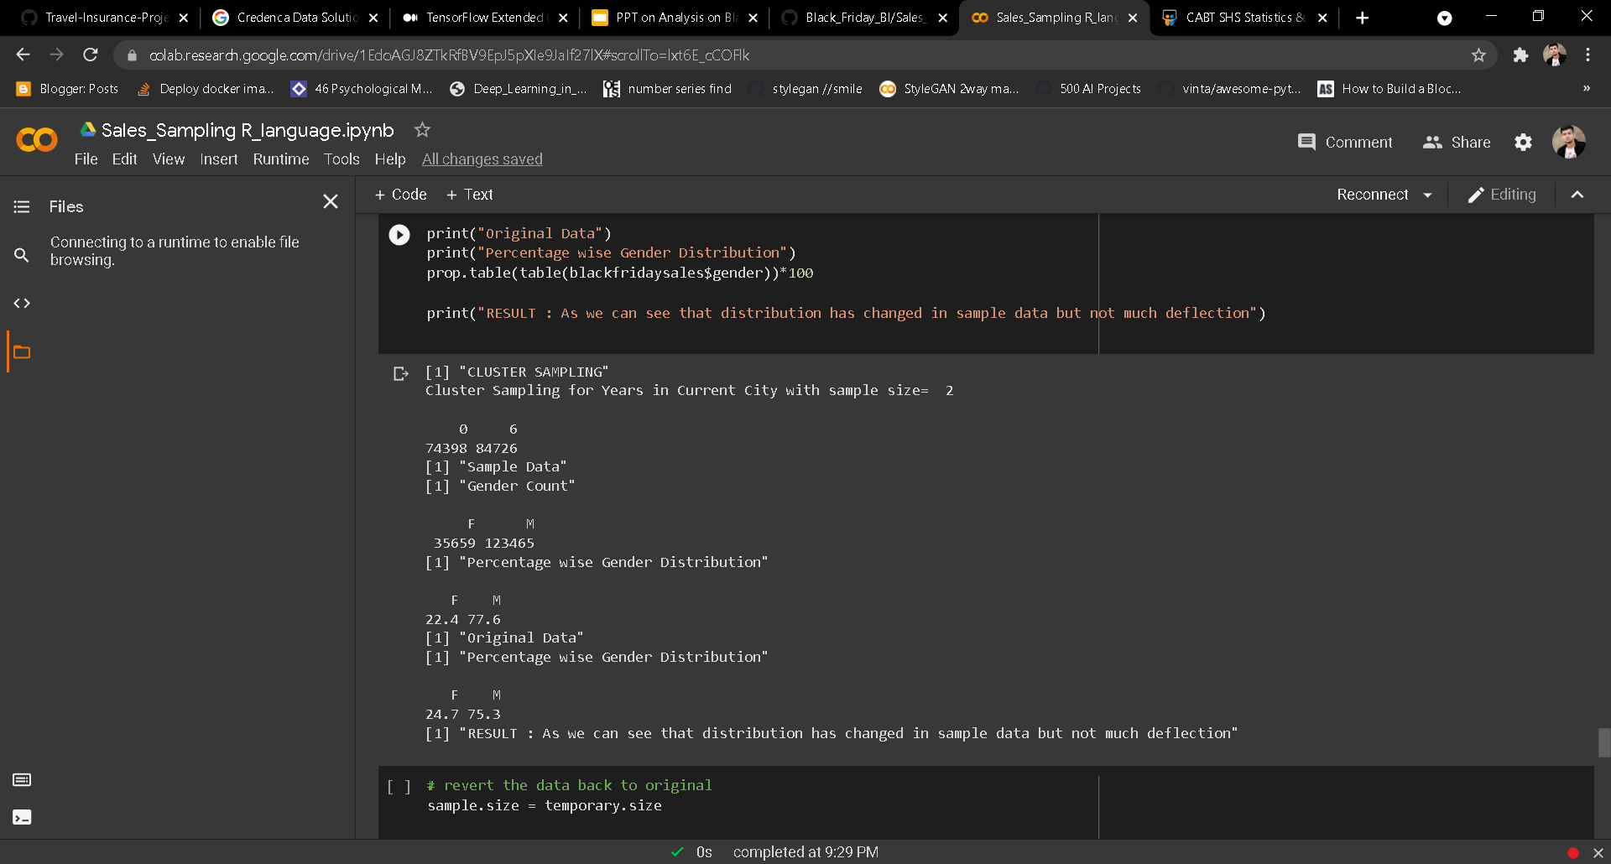
Cluster Sampling
Population is break into small groups or clusters, then some of the clusters are randomly selected

Slide 29
Sampling
Therefore maximum change in original vs sample in:
Systematic Sampling : Equal Probability
Stratified Sampling : Sample Size =10
Almost similar interpretation
Systematic Sampling : Unequal Probability

Slide 30
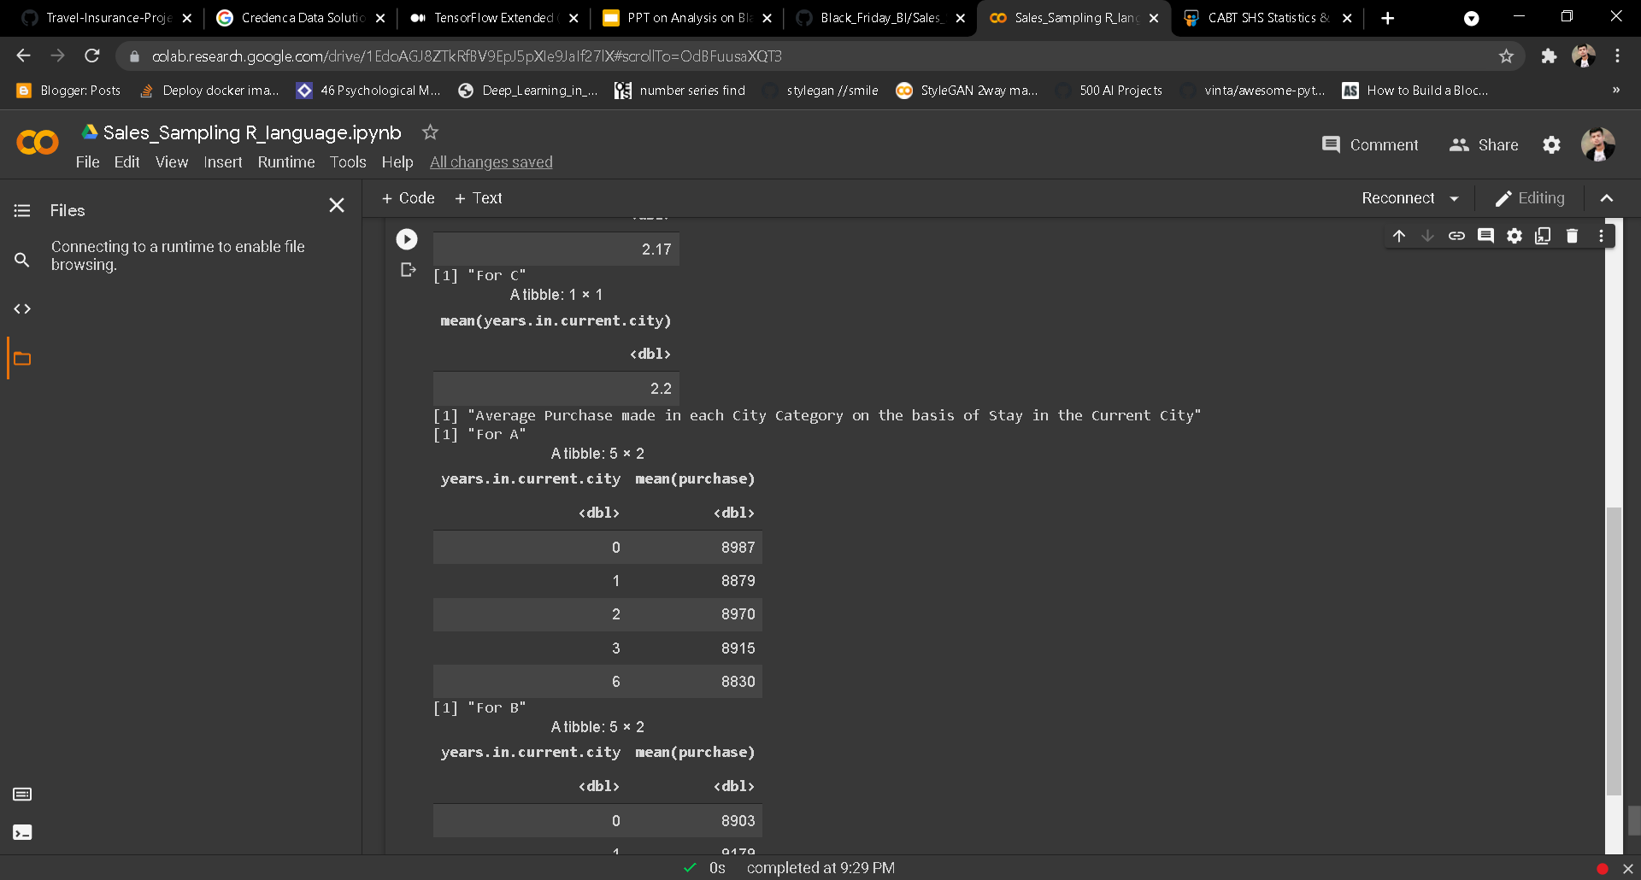
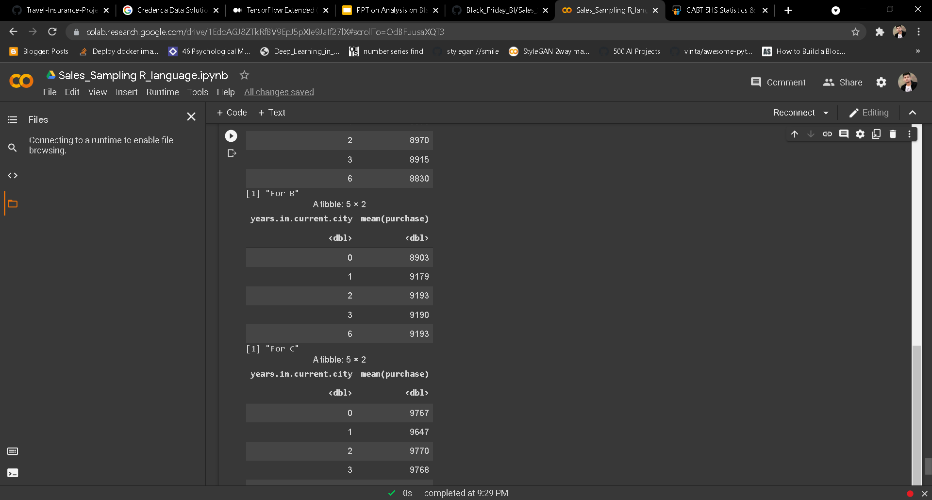
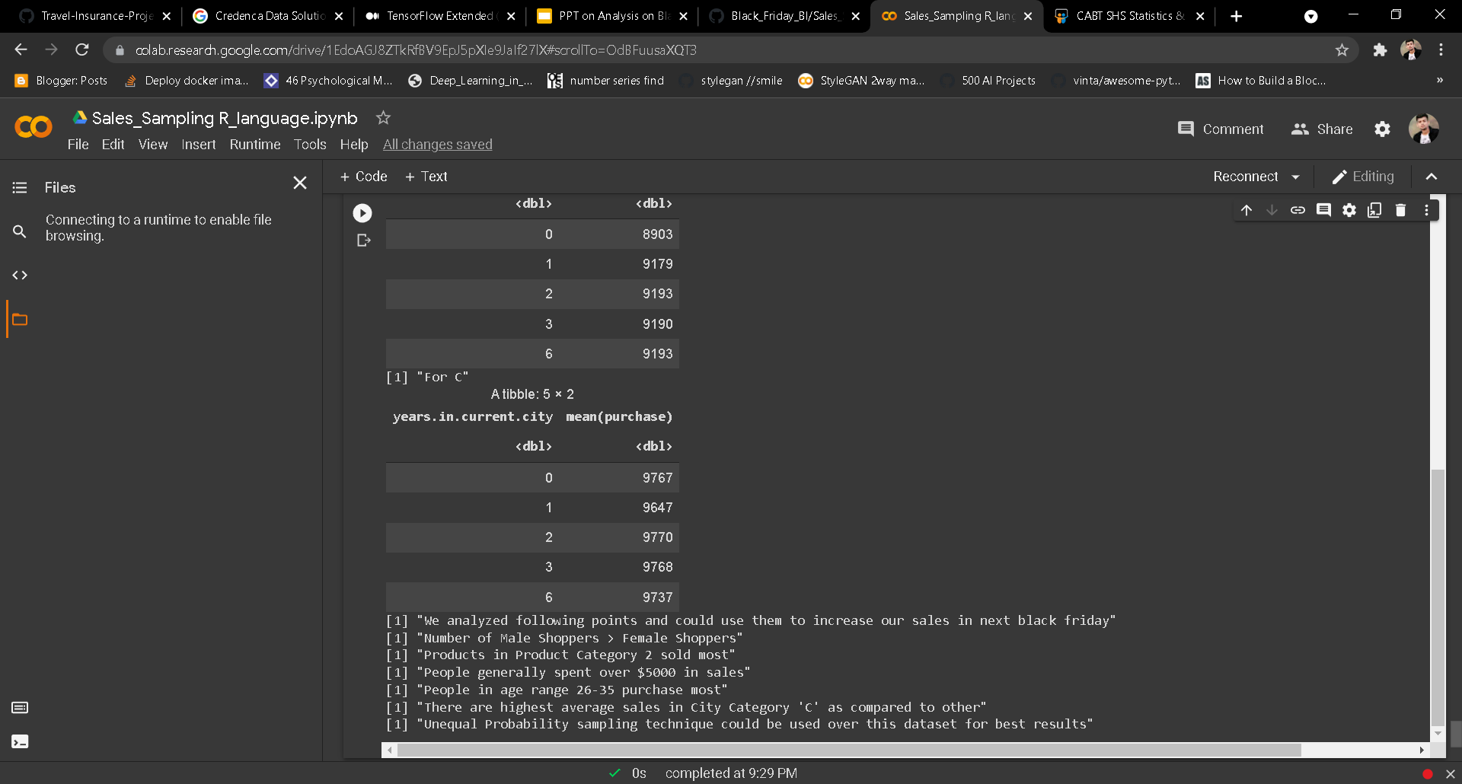
Other Observations (Used String/Tibble)
Average year a person live in following city:
A : 2.21
B : 2.17
C : 2.2
Average purchase in each city as per number of year :
A
B
C

Slide 31
Simple ML prediction
Feature Engineering :
Change categorical to numeric ( gender, marita status, city category)
In current years change 4+ to 6
Change bin to int in age column
ML model:
I applied only two ml models here
Linear regression rmse 4694.309
Decision tree rmse 3099.602

Slide 32
Conclusion
Number of Male Shoppers > Female Shoppers
Products in Product Category 2 sold most
People generally spent over $5000 in sales
People in age range 26-35 purchase most
There are highest average sales in City Category ‘C’ as compared to other
Unequal Probability sampling technique could be used over this dataset for best results

Slide 33
Thank you!! Questions?

